Slide 1
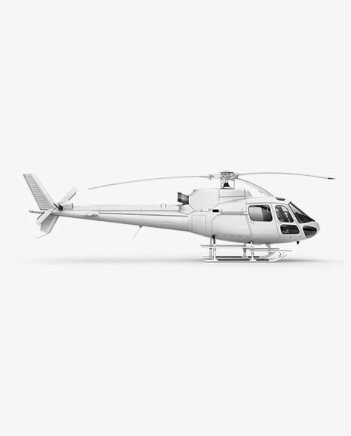
AIRBUS HELICOPTERS
H125-B3E
2018

Slide 2
SPECIFICATION
YEAR OF MANUFACTURE: 2018 MANUFACTURER: Airbus Helicopters MODEL: H125 B3e CONFIGURATION: Light Weight multi-role interior SERIAL NUMBER: 8635 REG: G-HITA CONDITION: Pre-owned (1 Owner from New) TOTAL TIME: 240 hrs TT FLIGHT RULES: VFR MAINTENANCE: As New....Manufacturers Warranty
PRICE : Make Offer
Displayed as the demonstration aircraft for the new narrow panel and MAX View H125 mods, G-HITA has only been used for private use and differences training with one owner since factory purchase. No load lifting, no charter and managed as part of a private fleet by professional staff.

Slide 3
AVIONICS
Garmin 500TXi
6 x Bose A20 Headsets
Helicopter Terrain Awareness System
Synthetic Vision System
Pilot & Co-Pilot Ipad Holders

Slide 4
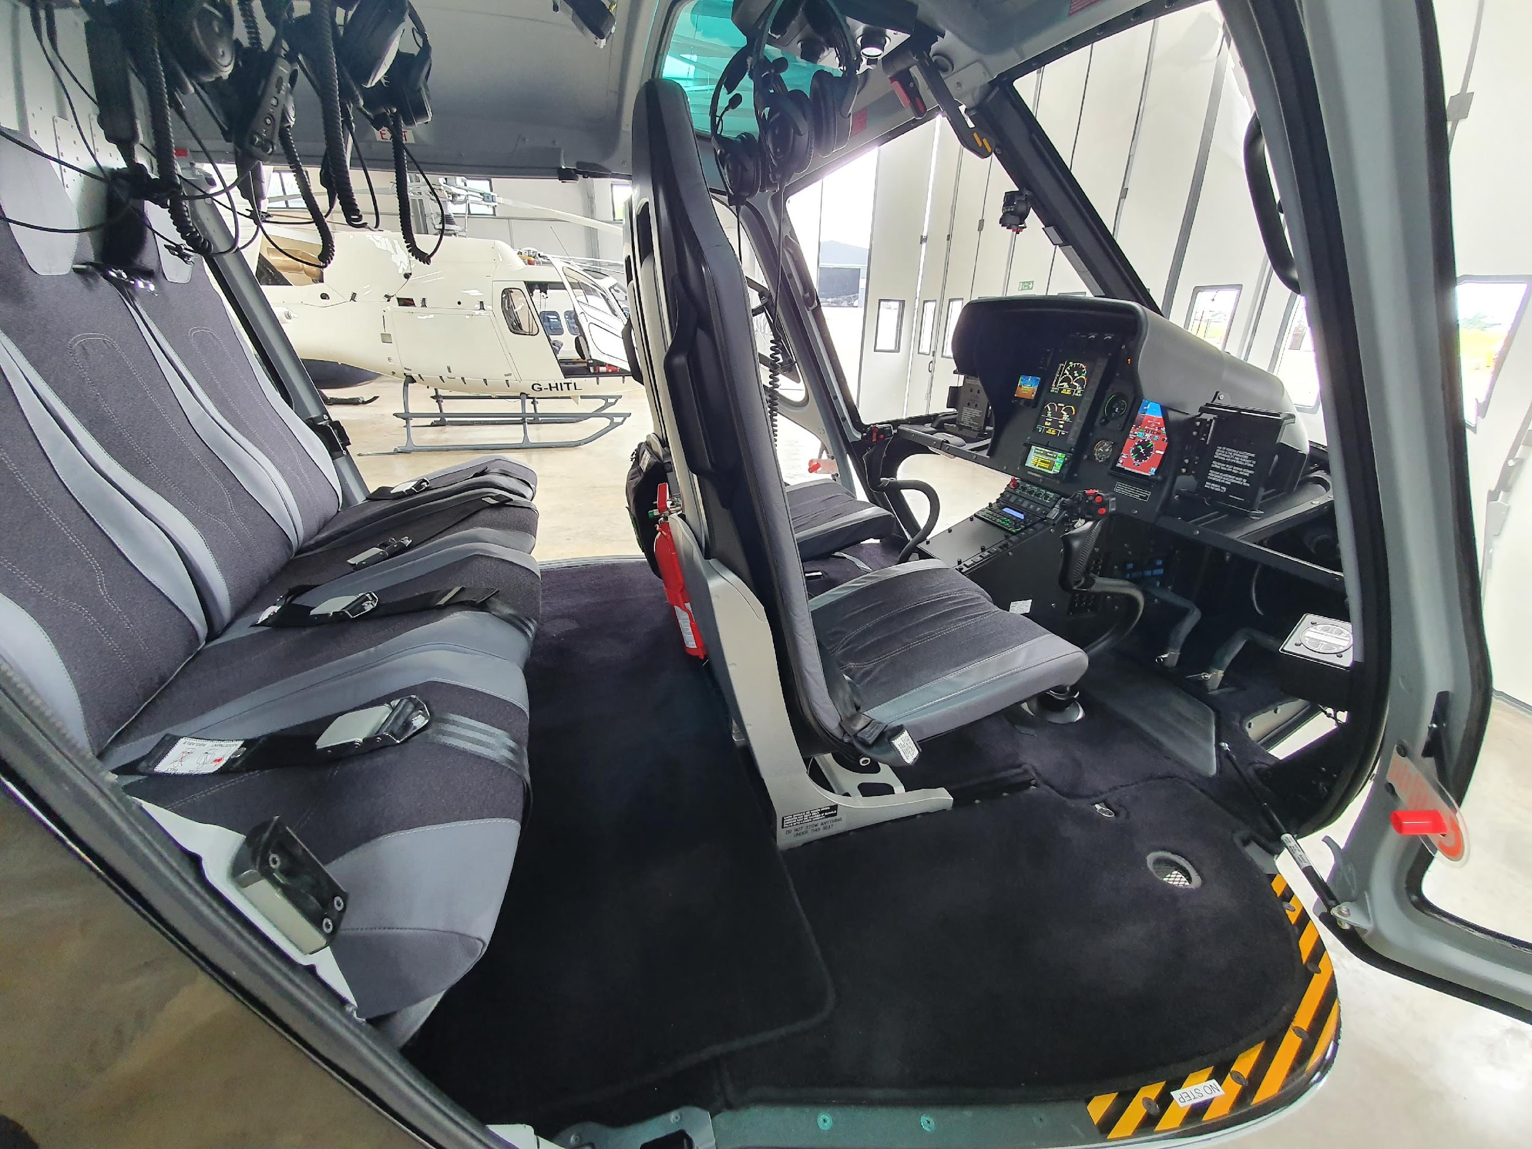
INTERIOR
Specified for light weight and versatility G-HITA is fitted with the 6 place interior. Pilot and co-pilot are the Airbus ‘stroking crash worthy type’. Rear bench in 2 sections for easy stowage to allow maximum cargo space.
All lining and materials are ‘as new’.

Slide 5
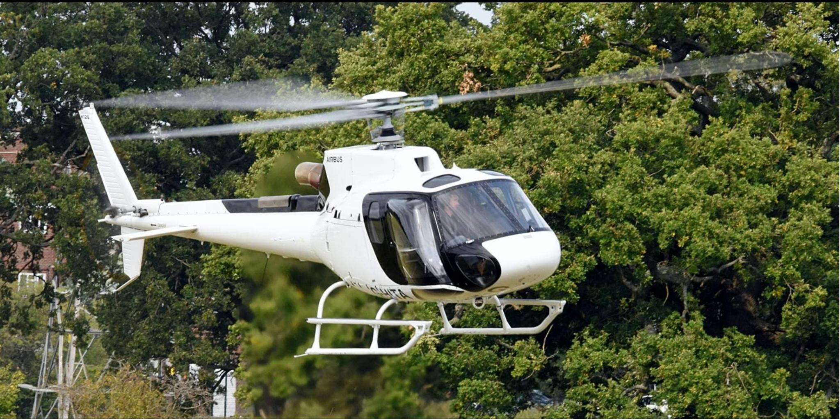
EXTERIOR
The aircraft is finished in a factory white and black paint scheme with white skid assembly, Black window surrounds highlighting the max view modification and black tail sections.
G-HITA is fitted with the pilot “high Visibility” extended door window section
A high-visibility rotor system paint scheme from new.
Specifications and details are subject to verification upon inspection. Aircraft are offered subject to prior sale or withdrawal from the market.

Slide 6
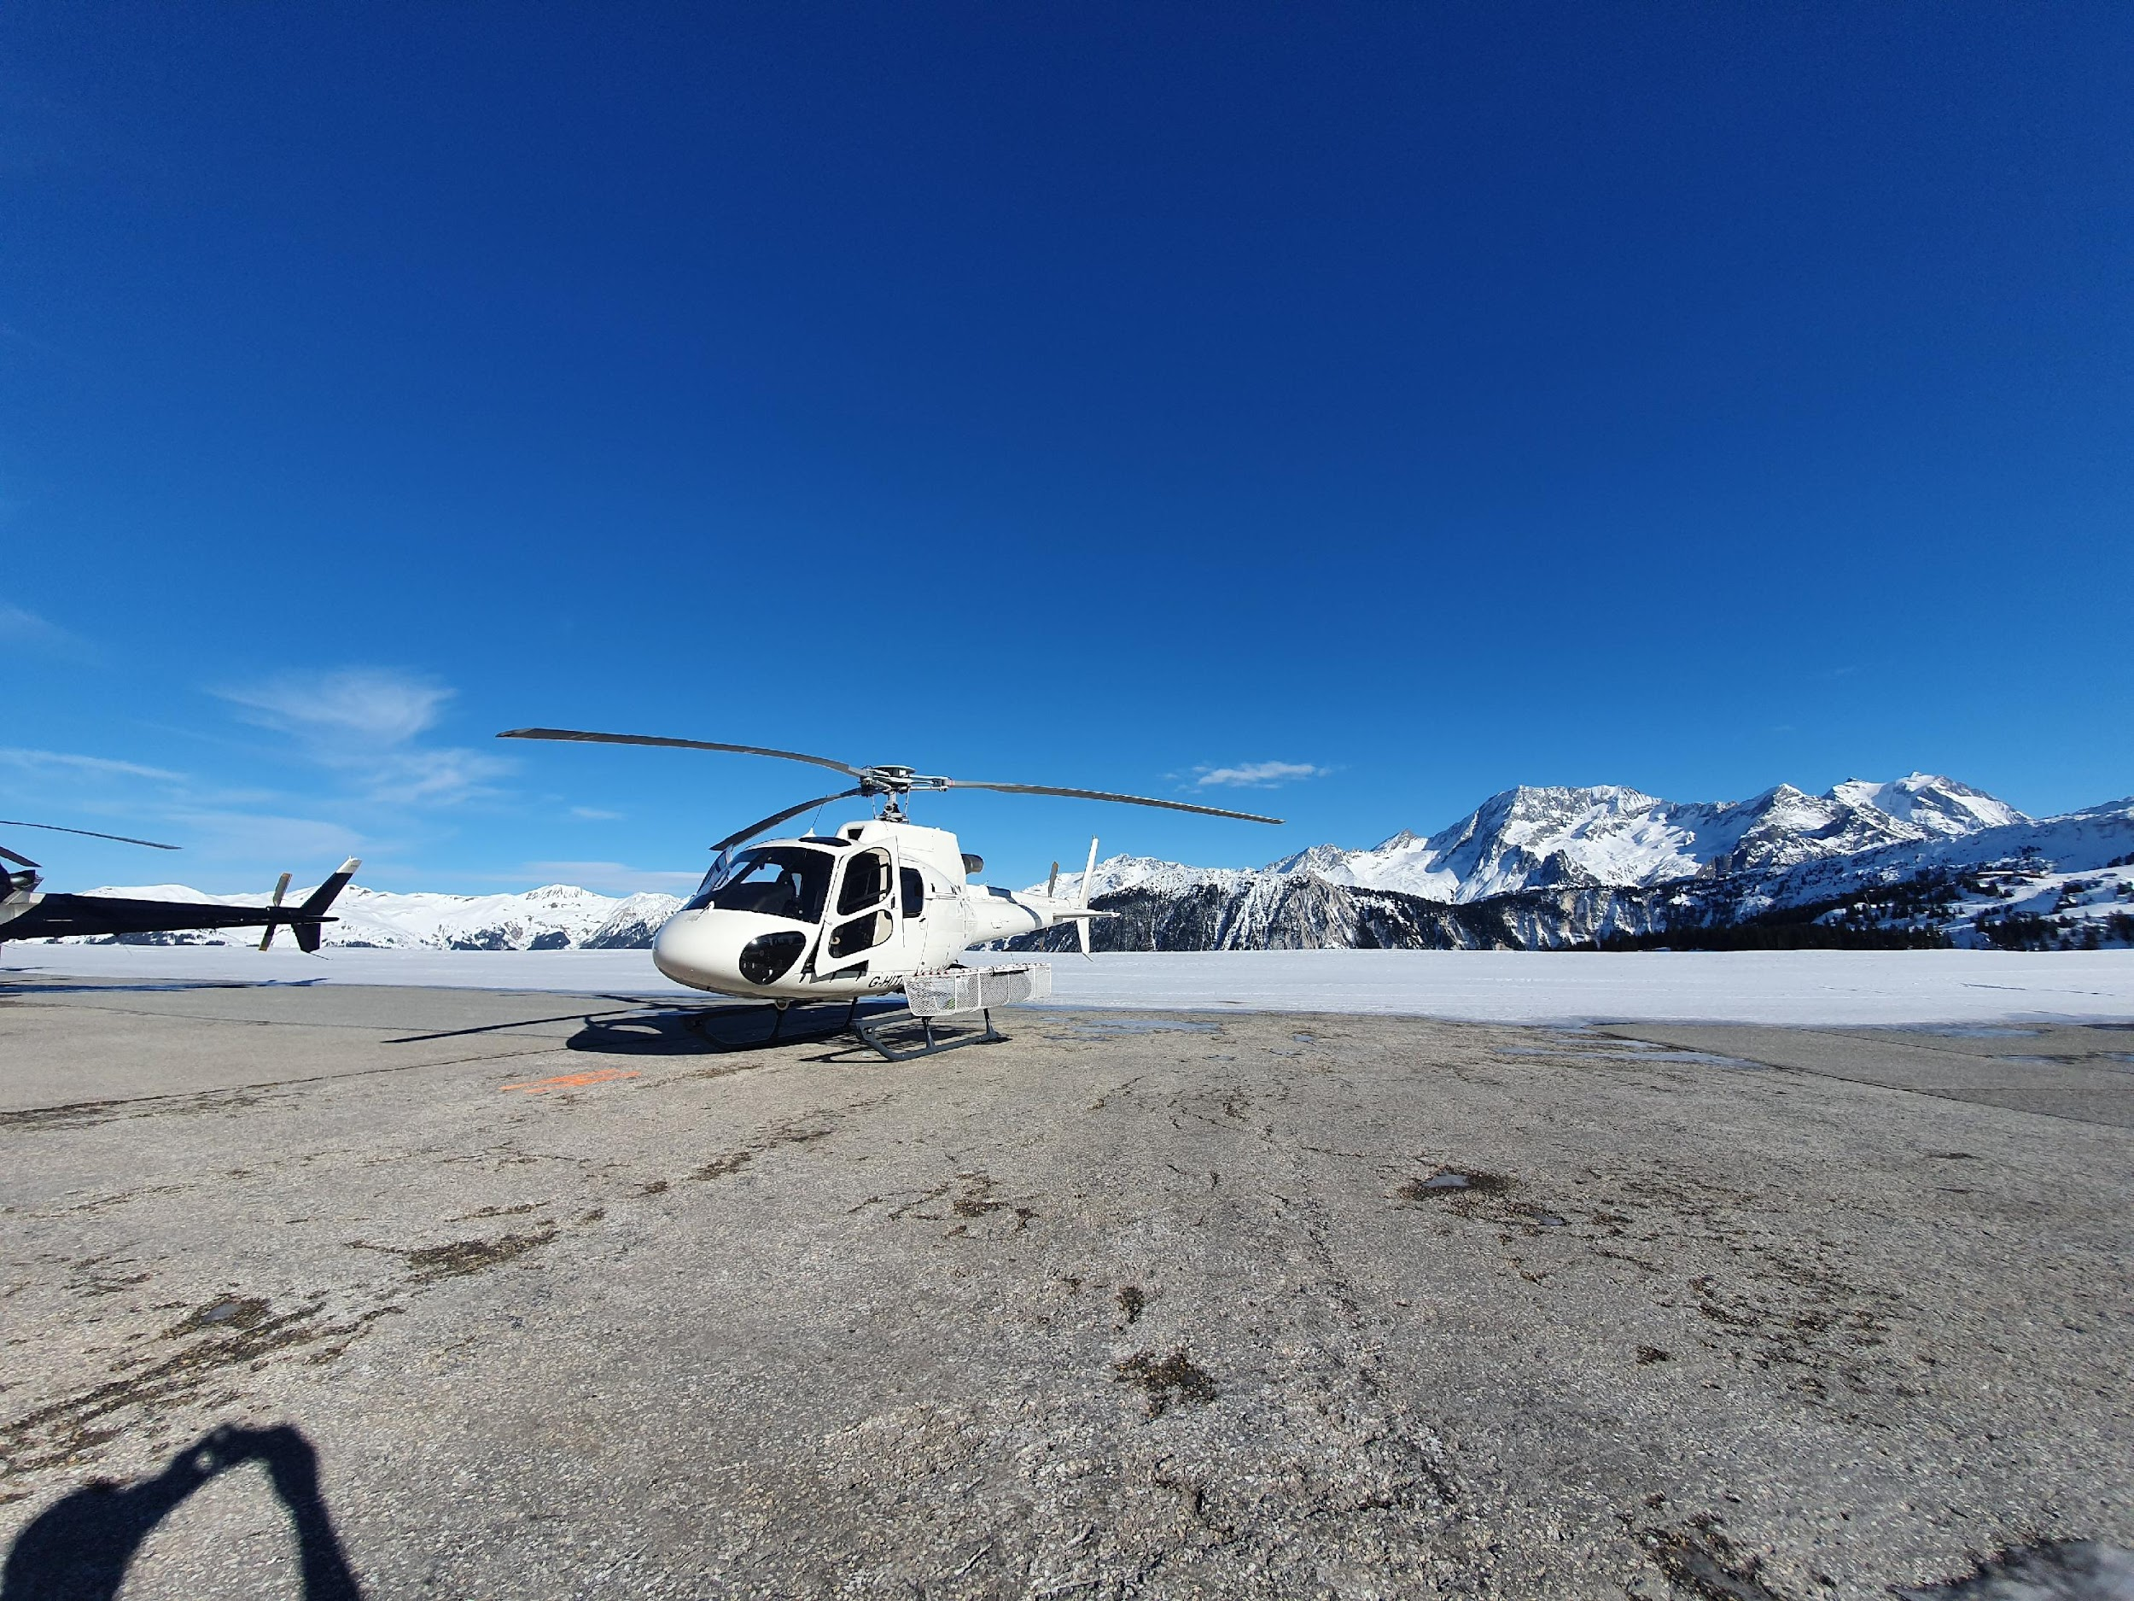
HILTI AIR LTD
For all enquiries:
Paul Forster
paul.forster@hiltiair.co.uk
+447554 747270
Specifications and details are subject to verification upon inspection. Aircraft are offered subject to prior sale or withdrawal from the market.

